Slide 1
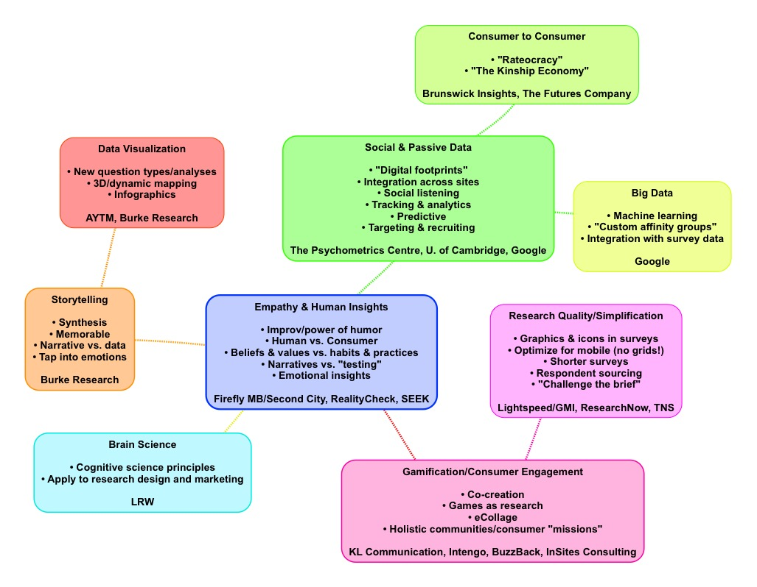
Innovation Insights Exchange (IIeX) NA 2015
Sarah Faulkner, Faulkner Strategic Consulting

